Slide 1
You Quote It, You Note It!

Slide 2
Introduction
Welcome to the "You Quote It, You Note It!" tutorial. This tutorial will explain what citation is and when and how to cite your sources properly. It will also explain the concept of plagiarism, so that you understand how to avoid plagiarizing the work of others. The tutorial will take about 10 minutes to complete.

Slide 3
<<Choose your avatar or create your character>>

Slide 4
What is citation?
Citation is the process of documenting the sources you use in your writing. A source is any document (a book, an article, a video, etc.) that you borrow ideas from to support your writing. The specific details of how you cite your sources depend on the citation style that you use, but generally, all citation includes two parts: an in-text citation (a note in the body of your paper) and a bibliography entry (a longer note at the end of your paper).

Slide 5
Let’s start by choosing the style that will be shown to you during this tutorial.

Slide 6
There are many different citation styles out there, but here are a few of the most common ones:
APA → This style originates in psychology but is used widely in the social sciences and sciences. If you’re not sure which style to choose, try this one.
MLA → This style is managed by the Modern Languages Association and is used primarily in the study of language and literature. English majors, this one is for you.
Chicago → This is another popular style in the humanities and social sciences. History and politics majors should choose this style.
ASA → This style is used exclusively in sociology. If you’re a sociology major, choose this style.

Slide 7
Now that you’ve selected your citation style, let’s dig into the basics:
Why cite sources?

Slide 8

While writing can often feel like a solitary activity, good academic writing is actually an asynchronous conversation involving many parties.

Slide 9

!!!
One party is you, the author. You are sharing your thoughts on paper (or on a screen), but those thoughts have not developed in your brain from nothing.

Slide 10
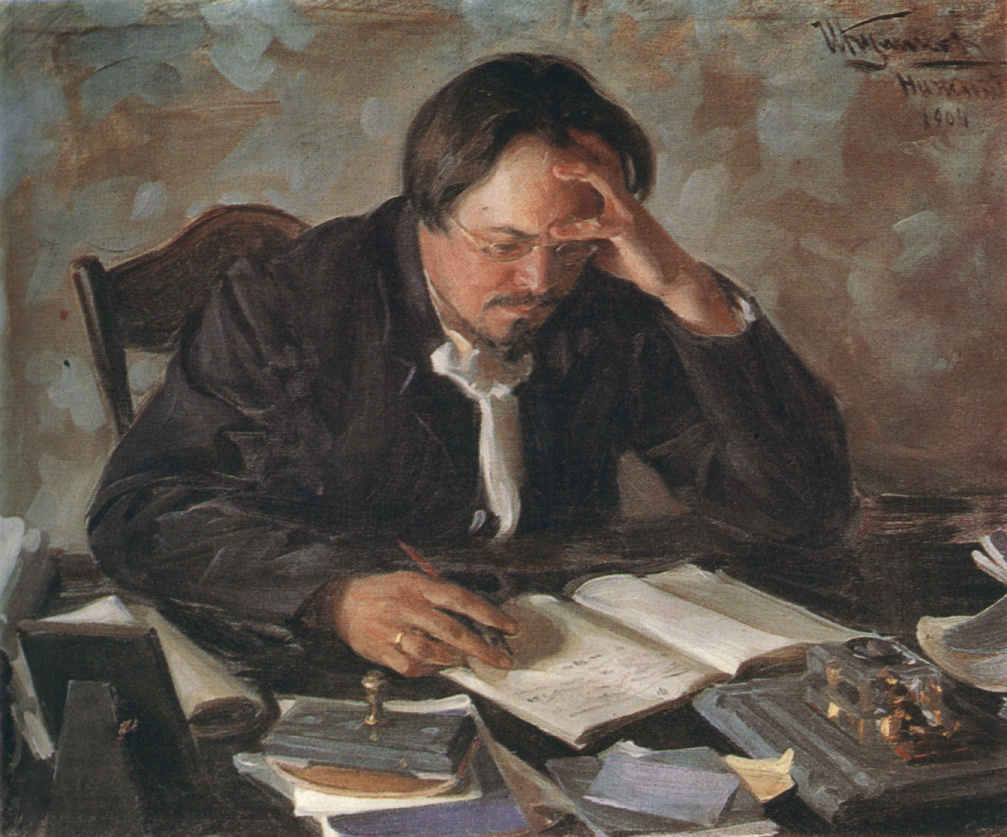

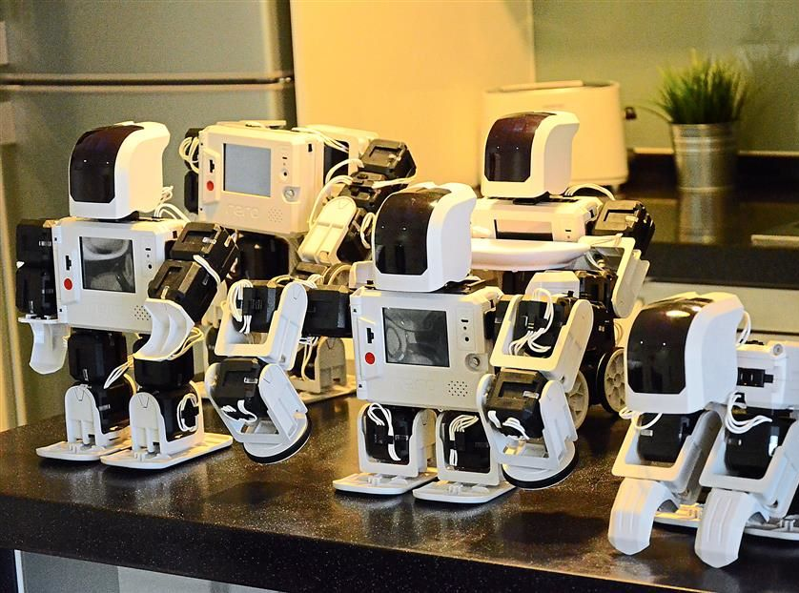
!!!
!!!
!!!
!!!
??
Class of 2083
!!!
You've received ideas from other researchers. They have, in a sense, spoken to you. They are part of the conversation. And then there are the people you will speak to through your writing -- people who will add your thoughts and ideas (and by extension, the thoughts and ideas of all the authors that you read) to their own ideas.

Slide 11
Citing sources is of fundamental importance to this conversation.
!!!

Slide 12
!!!
!!!
!!!
!!!
??
Class of 2083
Citations
!!!
By properly citing your sources, you can quickly provide important context for your research, and lead your readers to the research that you relied on to inform your work. Your readers can then engage with the ideas that came before yours, allowing them to contribute to the conversation.

Slide 13
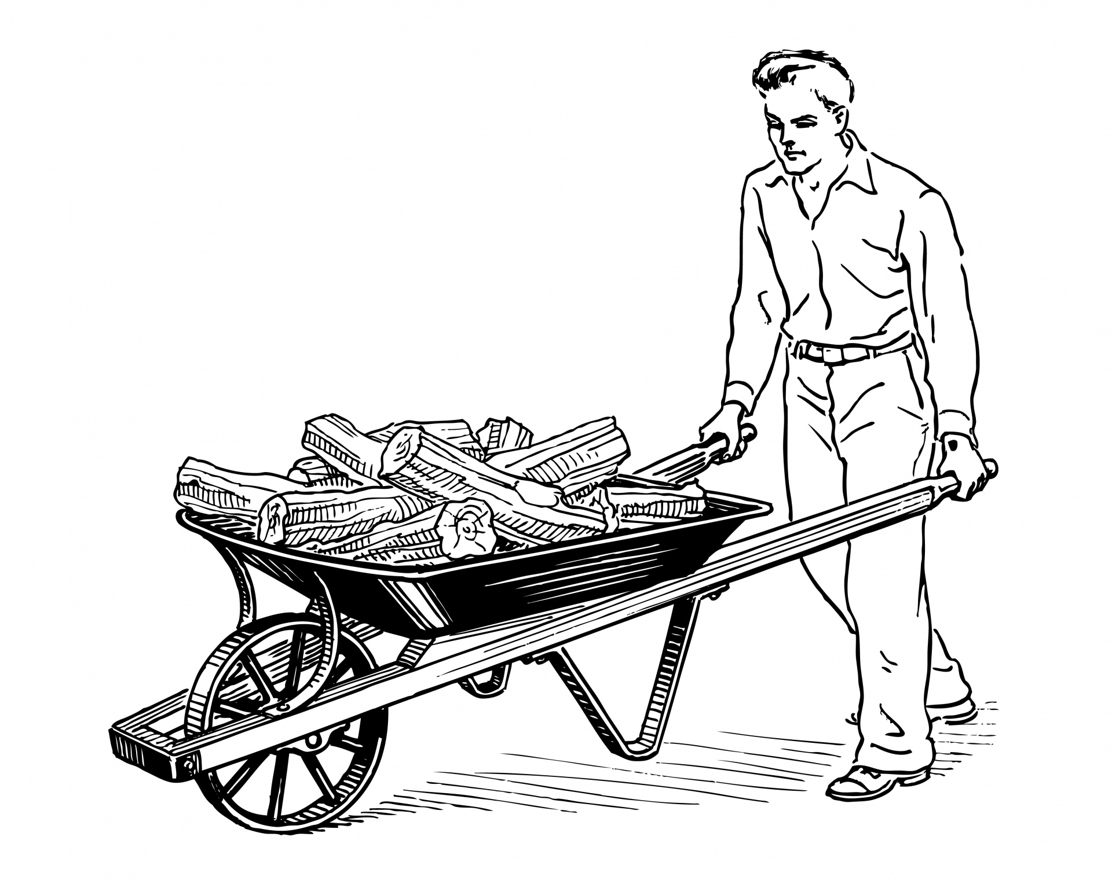


I’m a conversation!
Comment
Comment
Comment
!!!
It is this conversation that pushes all research forward. Researchers comment on each other's work, informing one another, and generating newer and better ideas within a given subject area.

Slide 14

Surprise! It’s a bibliography!
!!!
In this sense, properly citing your sources is a tremendous gift to future researchers.

Slide 15
Your
arguments
The work of others
The work of others
The work of others
The work of others
The work of others
The work of others
The work of others
!!!
And, as an added bonus, readers will be more likely to trust the validity of your arguments when they are clearly supported by the work of others.

Slide 16

Plagiarism
???
If all of those wonderful reasons to properly cite your sources aren’t enough to convince you to do it, there is something else you should know. There is a name for the act of failing to properly cite your sources: plagiarism. And plagiarism is a punishable academic offence!

Slide 17
Plagiarism
What exactly is plagiarism? Acadia's calendar defines it as "the act of presenting the ideas or words of another as one's own" (p. 44).
Using another writer's ideas or words is a normal part of academic work, but you must clearly indicate when you are doing this.
???

Slide 18
Plagiarism
Acadia's calendar continues: "Self-plagiarism is also a form of plagiarism. It is the presentation of the same work in more than one course without the permission of the instructors involved" (p. 44). Writing two different papers on the same topic for two different courses is fine, but you can't submit the exact same paper in both courses unless both instructors agree.
???

Slide 19
Plagiarism
If you are caught plagiarising, there are a range of penalties you may face, including:
Failing your assignment
Failing your course
Being expelled from university

Slide 20
Cite your
sources properly!
Plagiarism
!!!
Proper citation helps you write a better paper and stay out of trouble. And it helps future researchers too! Everyone wins with proper citation.

Slide 21
Now, let’s see if you can identify what plagiarism looks like.

Slide 22
<<Go to the appropriate .pptx and slides
APA → YQIYNI APA.pptx, slides 2-5
MLA → YQIYNI MLA.pptx, slides 2-5
Chicago → YQIYNI Chicago.pptx, slides 2-5
ASA → YQIYNI ASA.pptx, slides 2-5
>>

Slide 23
Tip #1
Paraphrasing improperly is still plagiarism! To paraphrase properly, you must:
really, truly use your own words and sentence structure: don't just change a couple of words;
cite the course with an in-text citation* AND in your Works Cited list.**
<<APA: *in-text citation **References list
ASA: *in-text reference **References list
Chicago: *footnote **Bibliography OR *in-text reference **Bibliography
MLA: *in-text citation **Works Cited list>>

Slide 24
Tip #2
Putting quotation marks around quotations isn't enough! You still have to insert an in-text citation AND cite the source fully in your Works Cited list.
<<customize term depending on style (e.g. "bibliography" instead of "Works Cited list": see slide 28)>>

Slide 25
Common knowledge

Slide 26
Common knowledge does not need to be cited. But what exactly is common knowledge?
“Common knowledge” refers to facts that are widely known to society at large (general common knowledge) or to a particular discipline (discipline-specific common knowledge).

Slide 27
General common knowledge includes things like basic facts about famous people (Mozart was born in 1756), well-known historical events (Canada won the Summit Series in 1972), or scientific facts (table salt is sodium chloride). It should be clear from the Summit Series example that what is general common knowledge in one culture or country is not necessarily common knowledge in another, so it is important to consider your intended reader's context.

Slide 28
Discipline-specific common knowledge refers to basic facts that would be common knowledge only to people well-versed in the discipline and not necessarily to society at large. For example, a reference to the zeroth law of thermodynamics would not need to be cited in a physics paper because it would be commonly known among physicists, but it would need to be cited in a paper intended for a non-specialist audience for whom it would not be commonly known.

Slide 29
When in doubt, cite! It is always safer to cite something that doesn't need to be cited than to not cite something that does need to be cited!

Slide 30
<<Go to the appropriate .pptx and slides
APA → YQIYNI APA.pptx, slides 6-11
MLA → YQIYNI MLA.pptx, slides 6-11
Chicago → YQIYNI Chicago.pptx, slides 6-11
ASA → YQIYNI ASA.pptx, slides 6-9
>>

Slide 31
Tip #3
Even if you found something online, you still must cite it! Using things from the web is no different than using print sources as far as plagiarism goes: you still have to cite the source. Just because something is publicly available on the web doesn't meant that it's in the public domain – and even if it really IS in the public domain, you still have to cite it.

Slide 32
Quoting vs Paraphrasing

Slide 33
Quoting is copying a source exactly, word for word. A direct quotation is placed between double quotation marks to indicate precisely where the copying begins and ends, and the source must always be cited. Paraphrasing is taking information from a source and putting it into your own words. A paraphrase is not indicated by quotation marks because it's not an exact copy, but the source must still be cited.

Slide 34
How do you know whether you should quote or paraphrase a source?
Quoting is only necessary when the exact words of the source matter. For example, if you are writing an English paper in which you are analyzing the actual words and phrases an author uses, it is helpful to your reader if you directly quote those words and phrases. Quotation is therefore much more common in the discipline of literature and language studies than in any other subject area. The other situations in which quotation is preferable to paraphrasing, in any discipline, are if the language of the original source is extremely well-known or historically significant (e.g. “To be or not to be”) or if it is so perfectly crafted that any attempt to paraphrase would diminish or fail to capture its meaning. These situations are rare, so apart from the literary essay, you should normally choose paraphrasing over quotation.

Slide 35
Quote if the exact words of the source matter.
Paraphrase if it's just the idea expressed by the source that matters.

Slide 36
<<Go to the appropriate .pptx and slides
APA → YQIYNI APA.pptx, slides 12-20
MLA → YQIYNI MLA.pptx, slides 12-20
Chicago → YQIYNI Chicago.pptx, slides 12-22
ASA → YQIYNI ASA.pptx, slides 10-18
>>

Slide 37
Tip #4
Use direct quotations sparingly. The majority of your paper should be in your own words.

Slide 38
Tip #5
If you’re unsure of if, when, or how to cite something, check a citation guide, ask your professor, or ask a librarian.

Slide 39

Tip #6
Document your sources immediately as you are doing your research. That way, when you’re writing your paper, you’ll always know where that perfect quotation came from.
This Photo by Unknown Author is licensed under CC BY-SA

Slide 40

To help you save, organize and manage your sources we suggest using Zotero! NEW
Zotero is a citation management tool that can help you track, organize, and cite your sources.
This tool is open source and freely available, meaning you can use it even after you leave Acadia University.
Visit https://libguides.acadiau.ca/zotero to learn more and for help setting Zotero up on your computer.
If you need further assistance, any of our Librarians can help you! Book an appointment with a Librarian either through our general email ref-desk@acadiau.ca or contact your Librarian http://library.acadiau.ca/about/people.html . Or drop by the Research Help Desk (10am to 4pm Monday to Friday) for help!

Slide 41

Thanks for taking our tutorial! We hope you’ve learned the basics about citation and how to avoid plagiarism.
Remember you can always get help from your professor or from the Library if you have any questions. Every student has their own Librarian! Find out who your Librarian is at http://library.acadiau.ca/about/people.html
You can also get help at the Research Help Desk in person, by phone [902-585-1170] or by email ref-desk@acadiau.ca
This Photo by Unknown Author is licensed under CC BY-NC-ND

Slide 42

Getting Help (end of tutorial) NEW
Chicago https://libguides.acadiau.ca/chicago-turabian
MLA https://libguides.acadiau.ca/MLA
APA https://libguides.acadiau.ca/apa
Writing Centre https://writingcentre.acadiau.ca/home.html
Plagiarism http://libguides.acadiau.ca/plagiarism
You Quote it, You Note it Quiz [insert link]

Slide 43
Other resources(end of tutorial – new slide)
Purdue Online Writing Lab (OWL)
APA Guide https://owl.purdue.edu/owl/research_and_citation/apa_style/index.html
Chicago Guide https://owl.purdue.edu/owl/research_and_citation/chicago_manual_17th_edition/cmos_formatting_and_style_guide/chicago_manual_of_style_17th_edition.html
MLA Guide https://owl.purdue.edu/owl/research_and_citation/mla_style/mla_style_introduction.html
Plagiarism: A Faculty Member's Guide
Plagiarism: A Student's Guide

Slide 44
Other resources (cont'd.)(end of tutorial – new slide)
Acadia University's statement on Academic Integrity and procedures concerning infractions of academic integrity: https://registrar.acadiau.ca/Registration.html

